Slide 1
Accelerate Deep Learning Inference Using Intel Technologies Optimization: Tools and Techniques
August 2019

Slide 2
Optimization Notice
Intel’s compilers may or may not optimize to the same degree for non-Intel microprocessors for optimizations that are not unique to Intel microprocessors. These optimizations include SSE2, SSE3, and SSSE3 instruction sets and other optimizations. Intel does not guarantee the availability, functionality, or effectiveness or any optimization on microprocessors not manufactured by Intel. Microprocessor-dependent optimizations in this product are intended for use with Intel microprocessors. Certain optimizations not specific to Intel microarchitecture are reserved for Intel microprocessors. Refer to the applicable product User and Reference Guides for more information regarding the specific instruction sets covered by this notice. Notice Revision #20110804.

Slide 3
Legal Notices and Disclaimers (1 of 2)
Intel technologies’ features and benefits depend on system configuration and may require enabled hardware, software, or service activation. Performance varies depending on system configuration. No computer system can be absolutely secure. Check with your system manufacturer or retailer or learn more at www.intel.com.
Performance estimates were obtained prior to implementation of recent software patches and firmware updates intended to address exploits referred to as "Spectre" and "Meltdown." Implementation of these updates may make these results inapplicable to your device or system.
Cost reduction scenarios described are intended as examples of how a given Intel-based product, in the specified circumstances and configurations, may affect future costs and provide cost savings. Circumstances will vary. Intel does not guarantee any costs or cost reduction.
This document contains information on products, services, and/or processes in development. All information provided here is subject to change without notice. Contact your Intel representative to obtain the latest forecast, schedule, specifications, and roadmaps.
Any forecasts of goods and services needed for Intel’s operations are provided for discussion purposes only. Intel will have no liability to make any purchase in connection with forecasts published in this document.
Arduino*101 and the Arduino* infinity logo are trademarks or registered trademarks of Arduino, LLC.
Altera, Arria, the Arria logo, Intel, the Intel logo, Intel Atom, Intel Core, Intel Nervana, Intel Xeon Phi, Movidius, Saffron, and Xeon are trademarks of Intel Corporation or its subsidiaries in the United States and other countries.
*Other names and brands may be claimed as the property of others.
Copyright © 2018, Intel Corporation. All rights reserved.

Slide 4
Legal Notices and Disclaimers (2 of 2)
This document contains information on products, services, and/or processes in development. All information provided here is subject to change without notice. Contact your Intel representative to obtain the latest forecast, schedule, specifications, and roadmaps. Intel technologies’ features and benefits depend on system configuration and may require enabled hardware, software, or service activation. Learn more at intel.com or from the OEM or retailer. No computer system can be absolutely secure.
Tests document performance of components on a particular test, in specific systems. Differences in hardware, software, or configuration will affect actual performance. Consult other sources of information to evaluate performance as you consider your purchase. For more complete information about performance and benchmark results, visit www.intel.com/performance.
Cost reduction scenarios described are intended as examples of how a given Intel-based product, in the specified circumstances and configurations, may affect future costs and provide cost savings. Circumstances will vary. Intel does not guarantee any costs or cost reduction.
Statements in this document that refer to Intel’s plans and expectations for the quarter, the year, and the future, are forward-looking statements that involve a number of risks and uncertainties. A detailed discussion of the factors that could affect Intel’s results and plans is included in Intel’s SEC filings, including the annual report on Form 10-K.
The products described may contain design defects or errors, known as errata, which may cause the product to deviate from published specifications. Current characterized errata are available on request. Performance estimates were obtained prior to implementation of recent software patches and firmware updates intended to address exploits referred to as "Spectre" and "Meltdown." Implementation of these updates may make these results inapplicable to your device or system.
No license (express or implied, by estoppel or otherwise) to any intellectual property rights is granted by this document. Intel does not control or audit third-party benchmark data or the web sites referenced in this document. You should visit the referenced web site and confirm whether referenced data are accurate.
Intel, the Intel logo, Pentium, Celeron, Atom, Core, Xeon, Movidius, Saffron, and others are trademarks of Intel Corporation in the United States and other countries. *Other names and brands may be claimed as the property of others.
Copyright © 2018, Intel Corporation. All rights reserved.

Slide 5
Smart Video Workshop Overview
Intel® Distribution of OpenVINO™ 101
2. Basic End-to-End Object Detection Example
Introduction
Introduction to Intel technologies for deep learning inference
Hardware acceleration techniques
3./4./5. Hardware Acceleration with CPU, Integrated GPU, Intel® Movidius™ NCS, FPGA
Hardware Acceleration
Each module contains a hands-on lab exercise that introduces various Intel technologies to accelerate computer vision application with hardware heterogeneity.
6. Optimization Tools and Techniques
Optimization
7. Advanced Video Analytics
Application

Slide 6
Optimizing Computer Vision Applications
Use OpenVINO:
Model Optimizer:
Use the right data type(FP16 or 32) for your target hardware and accuracy needs
Inference Engine:
Performance difference between using the inference engine (IE) and a non-optimized framework can be bigger than differences between accelerators
Set batch size
Use Async API while capturing video at the same time as doing the inference
Other Recommendations:
Use/train a model with the right performance/accuracy tradeoffs. Performance differences between models can be bigger than any optimization you can do at the inference app level
Don’t infer every frame if not needed
Use Intel® VTune™ Analyzer

Slide 7
Use the Correct Data Type

Slide 8
Use the Correct Data Type
 | FP32 | FP16
CPU | yes | no
GPU | yes | recommended
Intel® Movidius™ Myriad™ | no | yes
FPGA/DLA | no | yes
FPGA/DLA also supports FP11.

Slide 9
Use Inference Engine

Slide 10
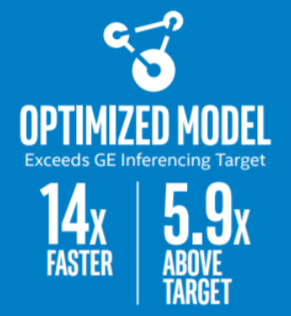
Use an Optimized Inference Engine vs. a non-optimized framework on Intel® CPU
vs. baseline
https://ai.intel.com/wp-content/uploads/sites/53/2018/03/IntelSWDevTools_OptimizeDLforHealthcare.pdf
The performance difference between running inference engine vs. unoptimized can be bigger than the difference between accelerators.

Slide 11
Why?
The CPU plugin was developed in order to provide opportunity for high performance scoring of neural networks on CPU, using the Intel® Math Kernel Library for Deep Neural Networks (Intel® MKL-DNN).
The CPU plugin uses OpenMP* in order to parallelize calculations.
The CPU Plugin supports inference on Intel® Xeon® with Intel® AVX2 and AVX512, Intel® Core™ Processors with Intel® AVX2, Intel Atom® Processors with Intel® SSE.
Notes:
file:///C:/Users/xinyex/Desktop/OpenVINO%20Workshop/OpenVINO%20R5.445%20documentation/_docs_IE_DG_supported_plugins_CPU.html

Slide 12
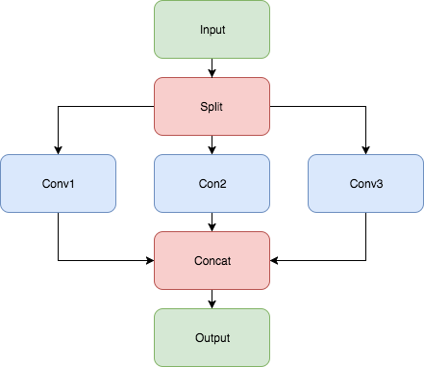
Internal CPU Plugin Optimizations
Merging of group convolutions.
It means that if a topology contains the following pipeline →
CPU plugin will merge it into one Convolution with the group parameter (Convolutions should have the same parameters).

Slide 13
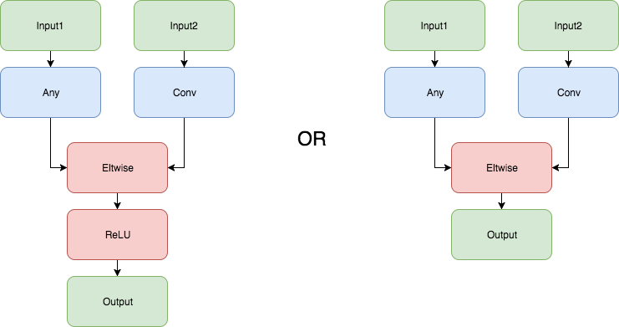
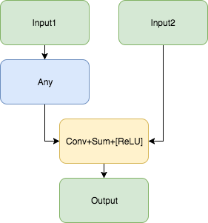
Internal CPU Plugin Optimizations
Fusing Convolution with ReLU or ELU. CPU plugin is fusing all Convolution with ReLU or ELU layers if these layers are located after the Convolution layer.
Fusing Convolution + Sum or Convolution + Sum + ReLu. To improve performance, the CPU plugin fuses the following structure:

Slide 14
Set Batch Size

Slide 15
Set Batch Size
To increase throughput, a convolutional neural network (CNN) could process the input data in batches.
What is batch size?
If we have a 3-channel(RGB) images that are 256x256 pixels. A single image can be represented as a 3 x 256 x 256 matrix. If we set the batch size to 10, then we are concatenating those 10 images together into a 10 x 3 x 256 x 256 matrix.
What is the best Batch size? – It depends on the model and available compute power
Increase batch size could help to get a higher throughput which means better inference FPS, but if it goes too large, your device will run out of memory to hold it.

Slide 16
Use Async

Slide 17
Inference Engine async API
Improves overall frame-rate of the application.
Executes a request asynchronously (in the background) and waits until ready, when the result is actually needed.
Continues doing things on the host, while the accelerator is busy.
The demo keeps two parallel infer requests, and, while the current is processed, the input frame for the next is captured. This essentially hides the latency of capturing, so the overall framerate is determined by the MAXIMUM(detection time, input capturing time) and not the SUM(detection time, input capturing time).

Slide 18
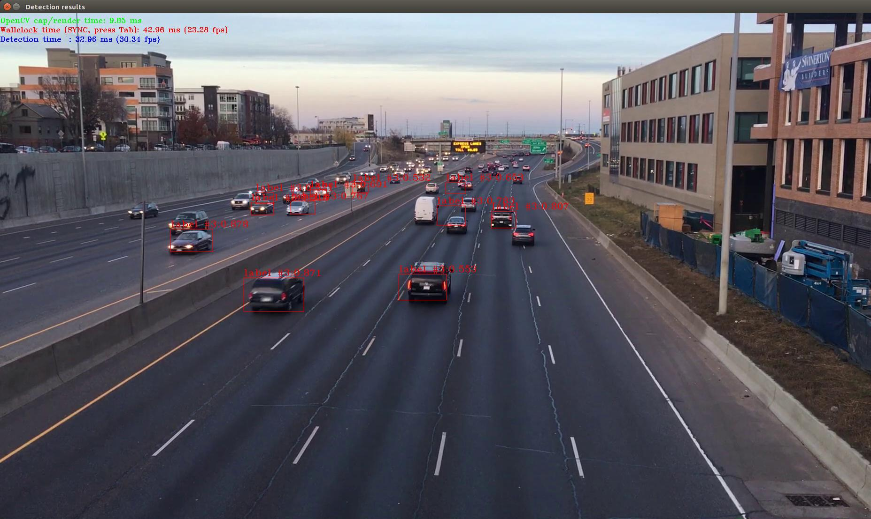
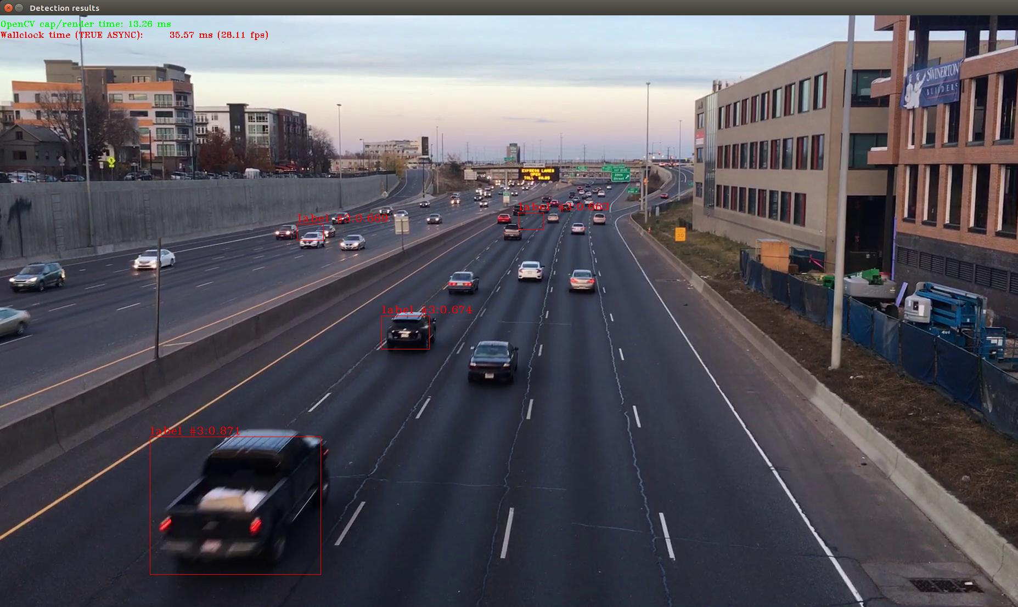
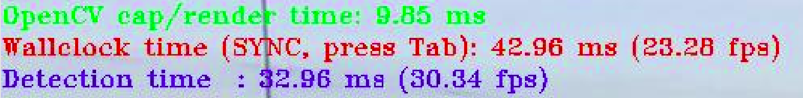

Running Object Detection Sample SSD async
$ ./object_detection_demo_ssd_async -i /home/intel/workshopApr25/workshop-tutorials/test_content/video/cars_1920x1080.h264 -m /home/intel/workshopApr25/workshop-tutorials/test_content/IR/SSD/SSD_GoogleNet_v2_fp32.xml
Synchronous Mode
Press Tab to Enable Asynchronous Mode

Slide 19
Pick the Right Model

Slide 20
Use/Train a Model with the Right Performance plus Accuracy Tradeoffs.
Performance is based on many factors:
Topography complexity/layer implementation plus scheduling
Number of color channels (that is, BGR vs. grayscale)
Model resolution

Slide 21
Exercise: Range of Model Performance Focus on the Inference Timing
Complete this table in the hands-on exercise:
 | CPU ms/frame | GPU ms/frame | Intel® Movidius™ Myriad™ X ms/frame
ssd512
ssd300
Mobilnet-ssd*

Slide 22
Exercise: Range of Model Performance Focus on the Inference Timing
Complete this table in the hands-on exercise:
 | CPU ms/frame | GPU ms/frame | Intel® Movidius™ Myriad™ X ms/frame
ssd512 | 1260.35 ms/frame | 649.604 ms/frame | 1385.13 ms/frame
ssd300 | 404.721 ms/frame | 227.864 ms/frame | 608.919 ms/frame
Mobilnet-ssd* | 18.8134 ms/frame | 20.8313 ms/frame | 38.5964 ms/frame

Slide 23
Don’t Infer If Not Needed

Slide 24
Tracking
Many ways to track:
Optical flow: the pattern of apparent motion of objects, surfaces, and edges in a visual scene caused by the relative motion between an observer and a scene.
Kalman filters
Single/simplistic tracking (what we show here)
Multiple object tracking: like above but find ways to identify each region so rectangles have a persistent identity over time

Slide 25
A Tracking Thought Experiment
Processing in batches already introduces latency
resize, reorder
Infer
read frames

Slide 26
What If We Did Less Inference?
Infer
previous position
Interpolate
read frames
Infer
Parse Output
resize, reorder

Slide 27
Determine If There Is Nothing to See
Inference is expensive to run each frame. It can save time to not run when there is nothing to identify.
Check motion vectors
Frame sizes
bgsubmog
SAD
These methods can be several orders of magnitude less expensive than inference. Use techniques to increase the total # of streams a system can watch.

Slide 28
Lab5 - Optimizing Computer Vision Applications
URL: https://github.com/intel-iot-devkit/smart-video-workshop/blob/master/optimization-tools-and-techniques/README.md
Objective: This tutorial shows some techniques to get better performance for computer vision applications with the Intel® Distribution of OpenVINO™ toolkit.
Estimated Complete Time: 40min

Slide 29
Use Intel® VTune™ Analyzer

Slide 30
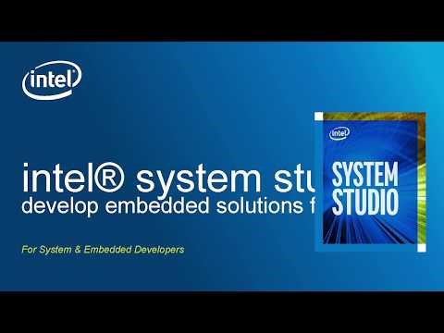
Use Intel® VTune™ Analyzer

Slide 31
Lab6 - Intel® VTune™ Amplifier Tutorial
URL: https://github.com/intel-iot-devkit/smart-video-workshop/blob/master/optimization-tools-and-techniques/README_VTune.md
Objective: This tutorial will show how to run Intel® VTune™ Amplifier on an Intel® Distribution of OpenVINO™ toolkit Inference Engine application.
Estimated Complete Time: 30min

Slide 32
Advanced Video Analytics Security Barrier Demo

Slide 33
Video Analytics in Intel® Distribution of OpenVINO™ Toolkit
Topology | Type | Description
license-plate-recognition-barrier-0001 | ocr | Chinese license plate recognition.
vehicle-attributes-recognition-barrier-0010 | object_attributes | Vehicle attributes recognition with modified RESNET10* backbone.
vehicle-license-plate-detection-barrier-0007 | detection | Multiclass (vehicle, license plates) detector based on RESNET10 plus SSD.

Slide 34
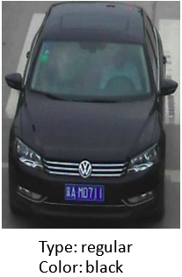
vehicle-attributes-recognition-barrier-0010 Use Case/High-Level Description
Vehicle attributes classification algorithm for a traffic analysis scenario.

Slide 35
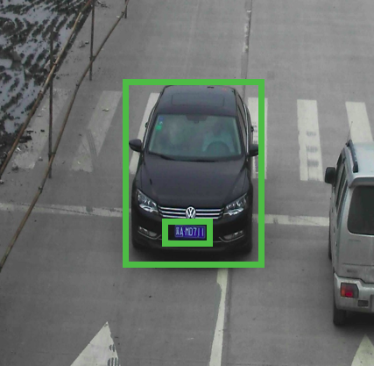
vehicle-license-plate-detection-barrier-007 Use Case/High-Level Description
RESNET* 10 plus SSD-based vehicle and (Chinese) license plate detector for "Barrier" use case.

Slide 36
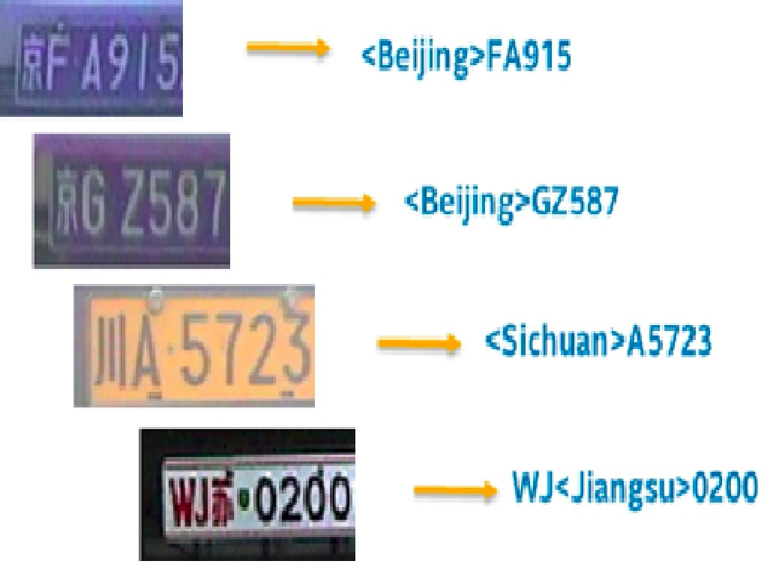
license-plate-recognition-barrier-0001 Use Case/High-Level Description
Small-footprint network trained E2E to recognize Chinese license plates in traffic scenarios.
Note: The license plates in the image are modified from the originals.

Slide 37
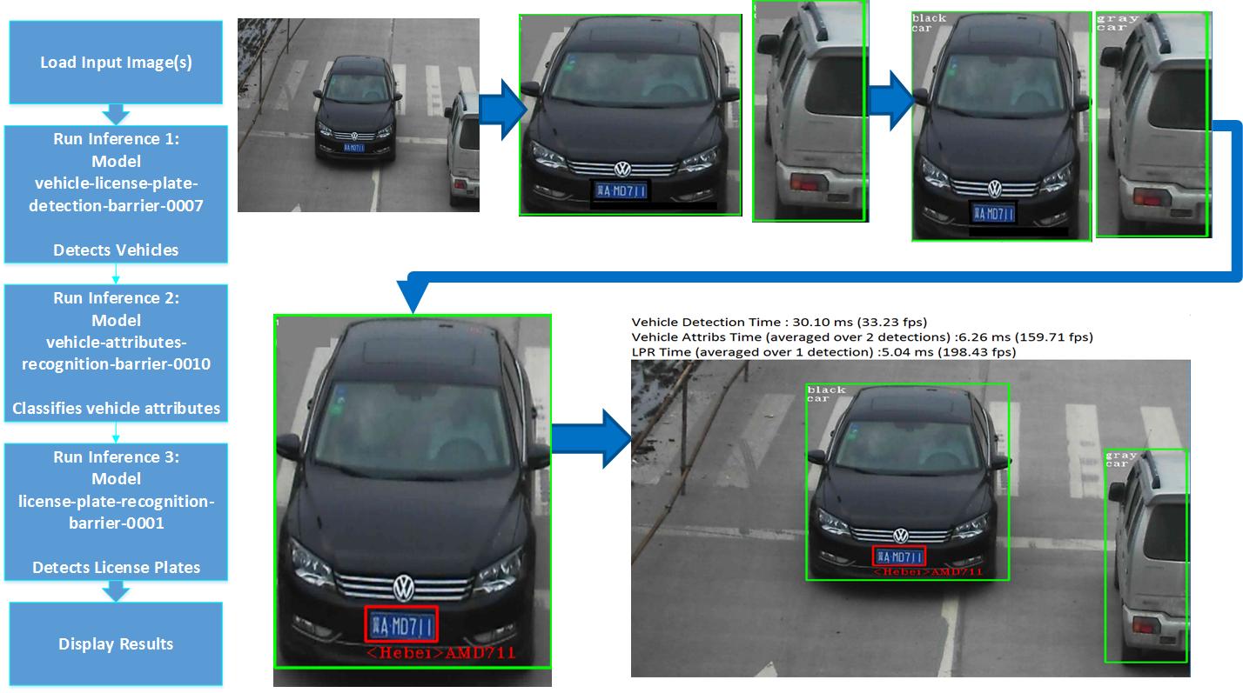
Security Barrier Demo

Slide 38
Lab7 - Advanced Video Analytics
URL: https://github.com/intel-iot-devkit/smart-video-workshop/blob/master/advanced-video-analytics/multiple_models.md
Objective: The tutorial shows some techniques for developing advanced video analytics applications.
Estimated Complete Time: 20min

Slide 39
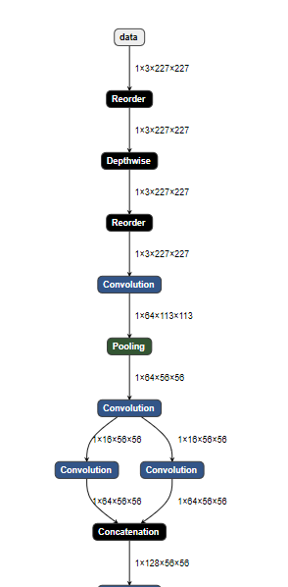
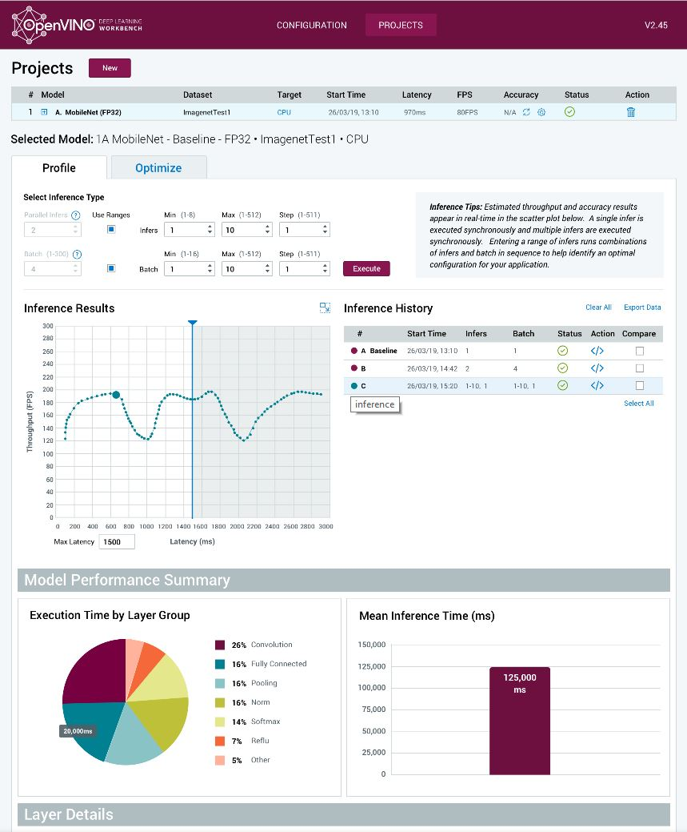
Deep Learning Workbench (Preview)
Deep Learning Workbench capabilities
Web-based tool - UI extension of Intel® Distribution of OpenVINO™ toolkit functionality
Visualizes performance data for topologies/ layers to aid in model analysis
Automate analysis for optimal performance configuration (streams, batches, latency)
Experiment with int8 calibration for optimal tuning
Provide accuracy info through accuracy checker
Direct access to Models from public set of Open Model Zoo

Slide 40
Deep Learning Workbench Data Flow
STEP 0: Train model with FW (Out-of-scope for Intel® Deep Learning Deployment Toolkit) | STEP 1: Convert model to IR file with use of Model Optimizer | STEP 2: Import Intermediate Representation (IR) file & dataset - then conduct multiple performance experiments | STEP 3: Deploy application
Deep Learning Workbench
(emulating single NN application)
Model Optimizer
Calibration Tool
Model Analyzer
Benchmark App
Trained
Model
IR
Accuracy Checker
Model Downloader
Aux. Capabilities
Data
Set
Inference Engine
IR = Intermediate Representation file

Slide 41
Workbench interfaces with key components
Calibration Tool – calibrates model in original precision (FP32, FP16) to lower precision (Int8) to reduce memory footprint and increase neural model performance. Implies some model accuracy drop that can be configured before model calibration.
Model Analyzer – provides theoretical data on the models like computational complexity (flops), number of neurons and memory consumption.
Benchmark App – helps to measure performance (throughput and latency) of a model, get performance metrics on per layer and overall basis
Accuracy Checker Tool – Check for accuracy of the model both original and after conversion to IR file using a know data set.
Model Downloader – Provides an easy way of accessing a number of public neural network models as well as a set of pre-trained Intel models
Aux Capabilities - Additional capabilities delivered by the toolset, e.g. ability to optimize model using Winograd algorithmic tuning.
Installation & Distribution
Distributed with Intel Distribution of OpenVINO toolkit
Build your local docker image from package (build scripts)
Build your local docker image by copying and running dockerfile from documentation
Download docker image from DockerHub
Work in progress – will depend on decision of OpenSource PDT
Can be used for internal experiments (at least)

